Slide 1
Introduction to Surface-Water Field Methods
Site selection, datum, and example stations

Slide 2
Streamgauge Site Selection
Blackfoot River near Henry, ID

Slide 3
Gauge site criteria
The location of a gauging station is dependent on the specific purpose of the streamflow record.
The ideal gauge site satisfies the
following criteria:
Snake River near Moran, WY
The general course of the stream is straight for about 300 ft upstream and downstream
from the gauge site.
The total flow is confined to one channel at all stages, and no flow bypasses the site
as sub-surface flow.
3. The streambed is not subject to scour and fill and is free of aquatic growth.

Slide 4
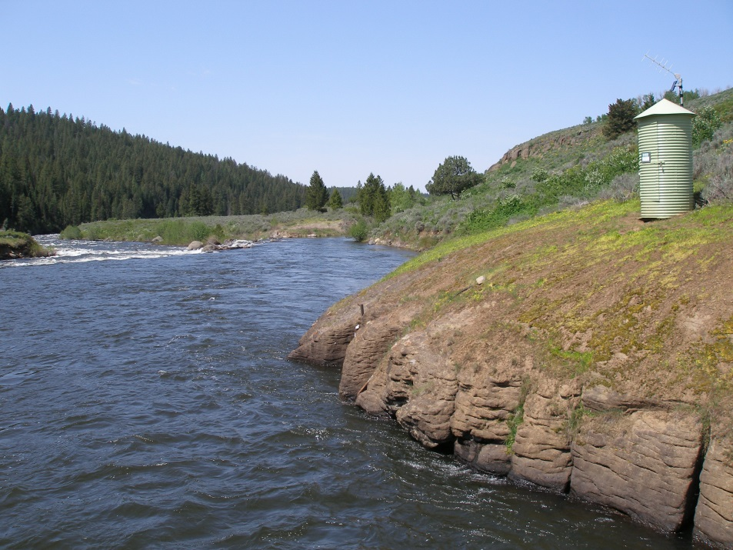
Gauge site criteria
Banks are permanent, high enough
to contain floods, and are free of
brush.
Unchanging natural controls are
present in the form of a bedrock
outcrop or stable riffle for low
flow and a channel constriction for
high flow.
6. A pool is present upstream from the control at extremely low stages to ensure a recording of stage at extremely low flow.
Falls River above the Yellowstone Canal near Squirrel, ID

Slide 5
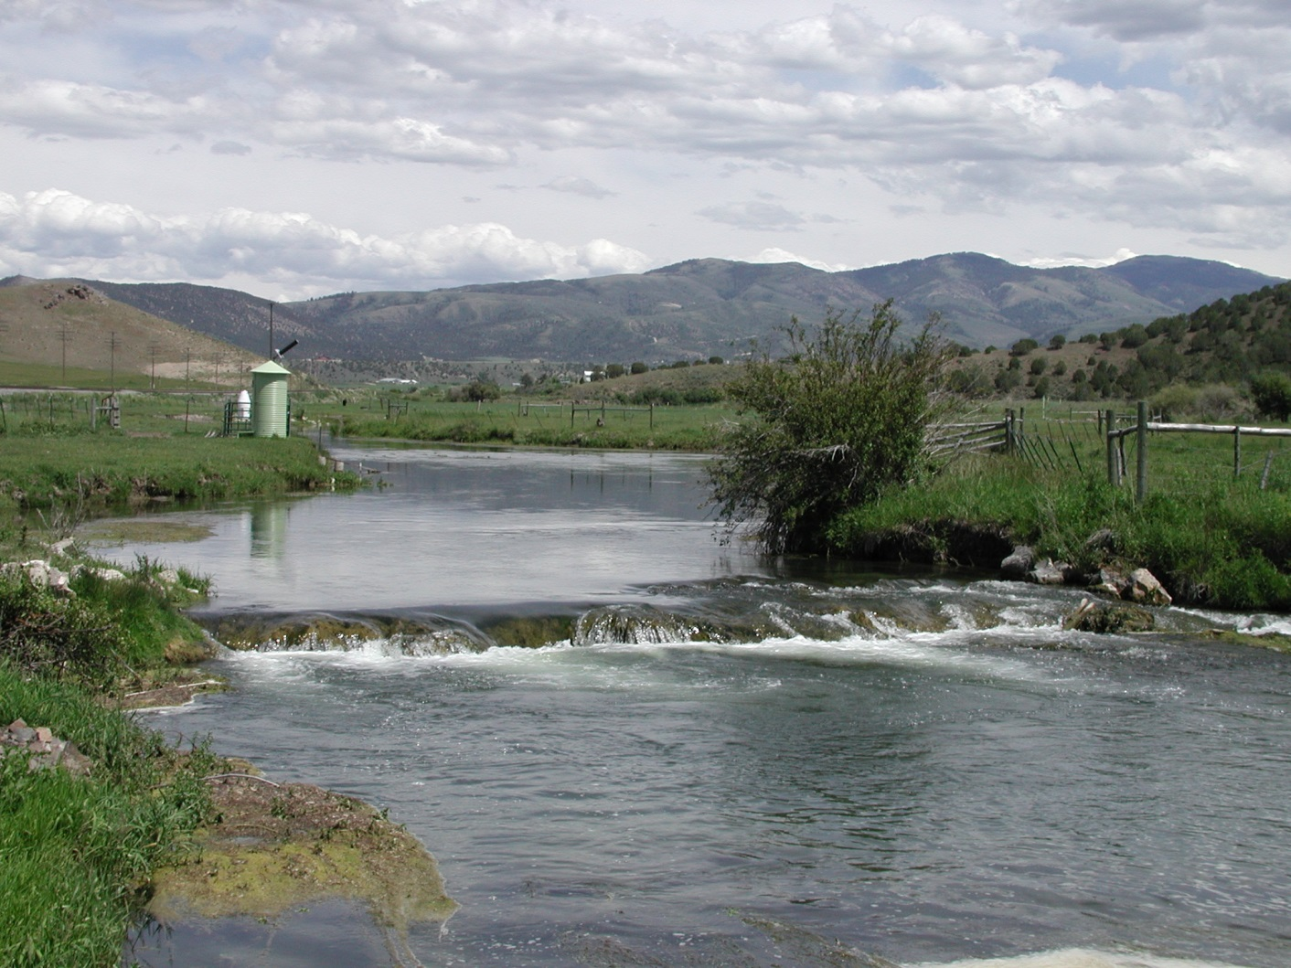
The control is that physical feature in the channel that controls the elevation of the gauge pool

Slide 6
Good controls are…
Permanent (Stable)
Not subject to scour and fill
No vegetation on banks, bed, or floating in stream
Not susceptible to ice formation

Slide 7
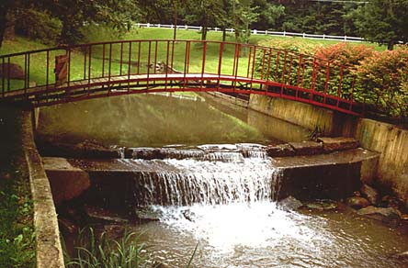
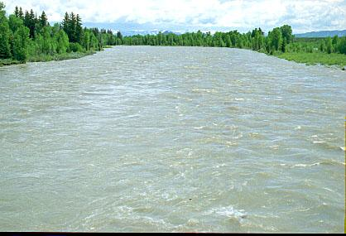
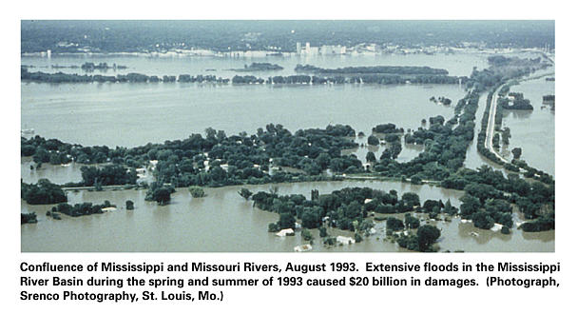
Types of Controls
Section
Channel
Floodplain
Notes:
2 major classifications of controls

Slide 8
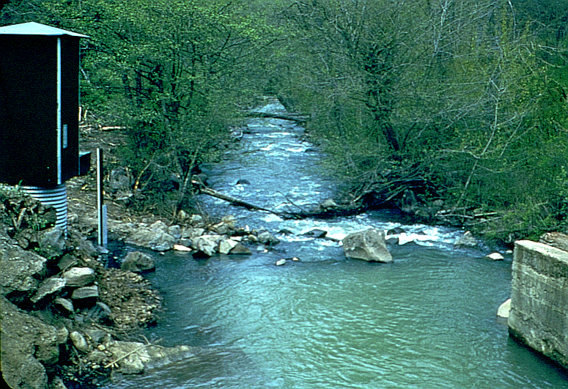
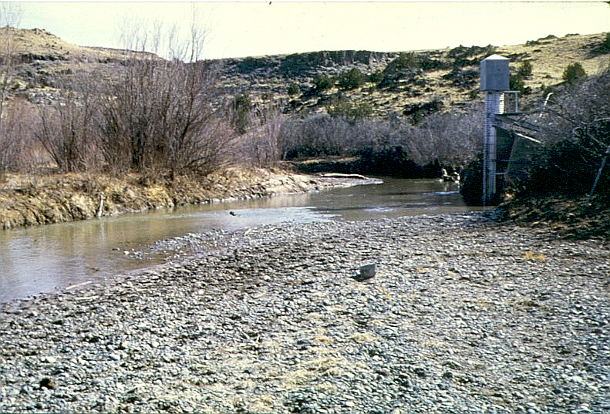
Examples of Controls – “Section”
A “section control” exists when the geometry of a single cross section a short distance downstream from the gauge is such as to constrict the channel, or when a downward break in bed slope occurs at the cross section.

Slide 9
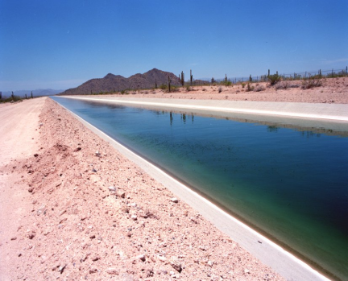
Examples of Controls – “Channel”
A “channel control” exists when the geometry and roughness of a long reach of channel downstream from the gauging station control the relation between stage and discharge.

Slide 10
Examples of Controls – “Floodplain”
Overbank flow

Slide 11
Different Controls, Same Site
Section Control
Section Control under 25 Feet of Water
(Channel Control)

Slide 12
Examples of Controls - Changes
(Dam) Beavers

Slide 13
Examples of Controls - Changes
Vegetation - Grasses

Slide 14
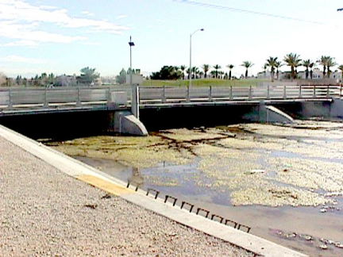
Examples of Controls - Changes
Vegetation - Algae

Slide 15
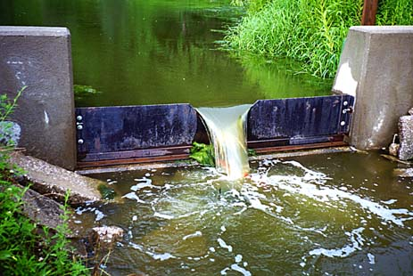
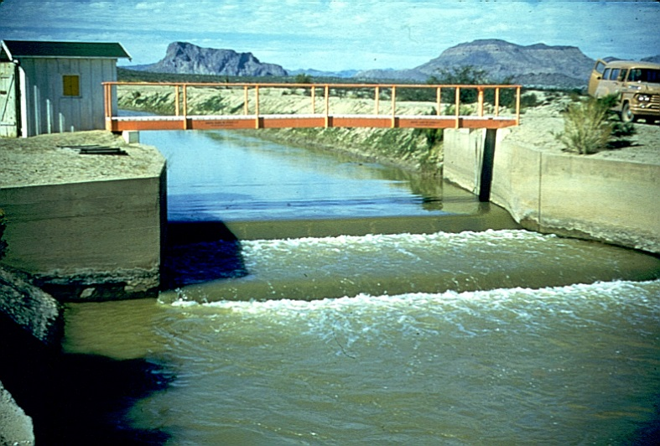
Artificial Controls
An artificial control is a structure built in a stream channel to stabilize and constrict the channel at a section
They are very SENSITIVE and STABLE
Notes:
Most of the photos so far have been of natural controls, but controls can also be man-made

Slide 16
Controls are important because they determine the shape of stage-discharge ratings

Slide 17
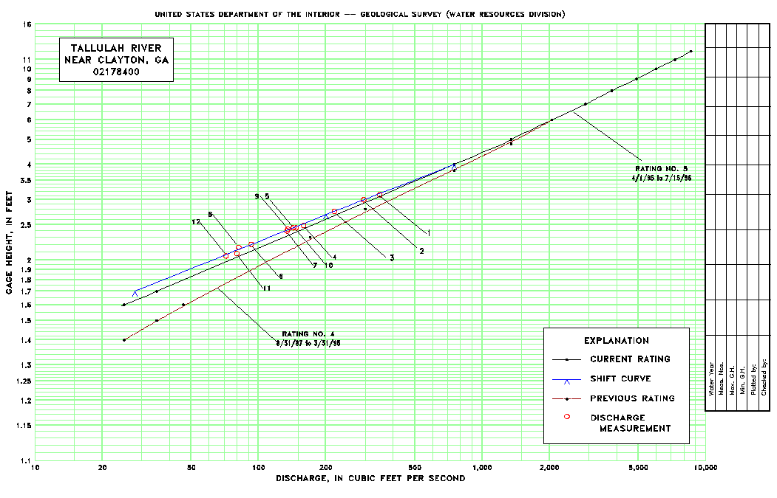
Stage-Discharge Relation
The conversion of a record of stage to a record of discharge is made by the use of a stage-discharge relation
This relation is often referred to as a "rating"

Slide 18
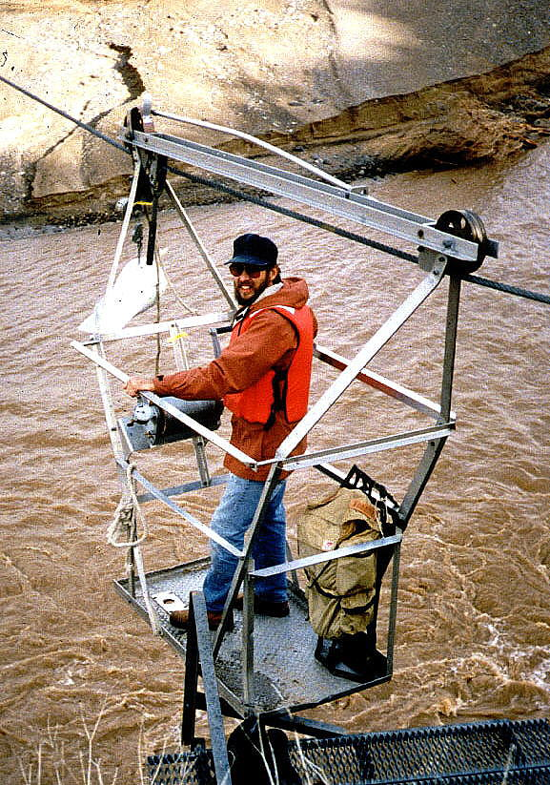
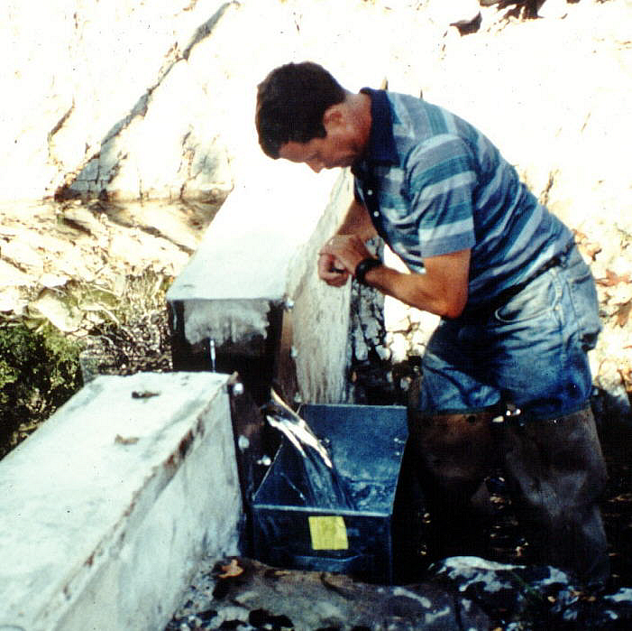
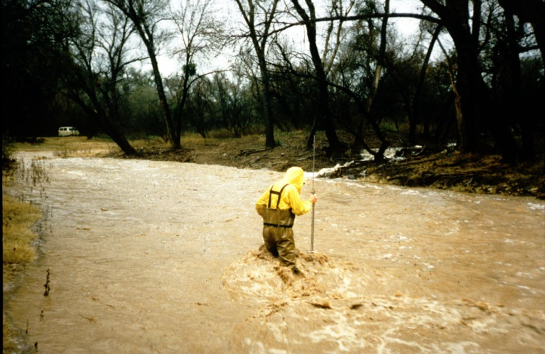
Ratings are developed by making discharge measurements
Notes:
Ratings are developed by making discharge measurements. To properly develop ratings, discharge must be measured at all stages. Otherwise the relation between stage and discharge will be uncertain for some ranges in stage.

Slide 19
Examples of rating curve shapes
Overbank
Channel
Control
Section
Control

Slide 20
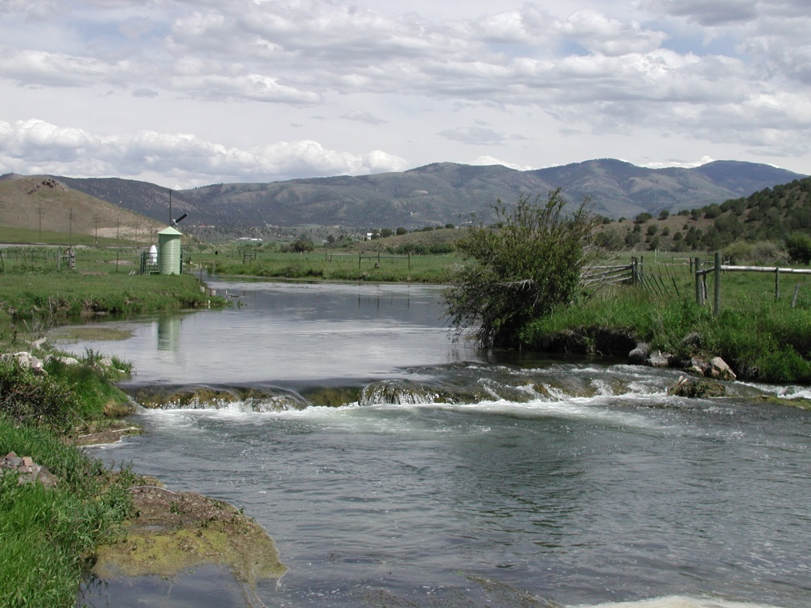
Gauge site criteria
The gauge site is far enough
upstream from the confluence
with another stream or from tidal
effect to avoid being influenced by the other stream or the tide
A satisfactory reach for measuring the discharge at all stages is available
within reasonable proximity of the gauge site. (It is not necessary that low
and high flows be measured at the same stream cross section.)
The site is readily accessible for ease in installation and operation of the
gauging station.
Portneuf River at Topaz, ID

Slide 21
Gauge site selection
The channel should be straight and uniform for a distance long enough to support uniform flow.
Measurement Section
Control
Riffle
Flow
W
5W
2W
Notes:
The diagram on this slide summarizes attributes of an ideal measurement section, as described on the previous slide. Ideally, the measuring section should be 5 channel widths below the most upstream riffle and approximately 2 channel widths above the control.

Slide 22
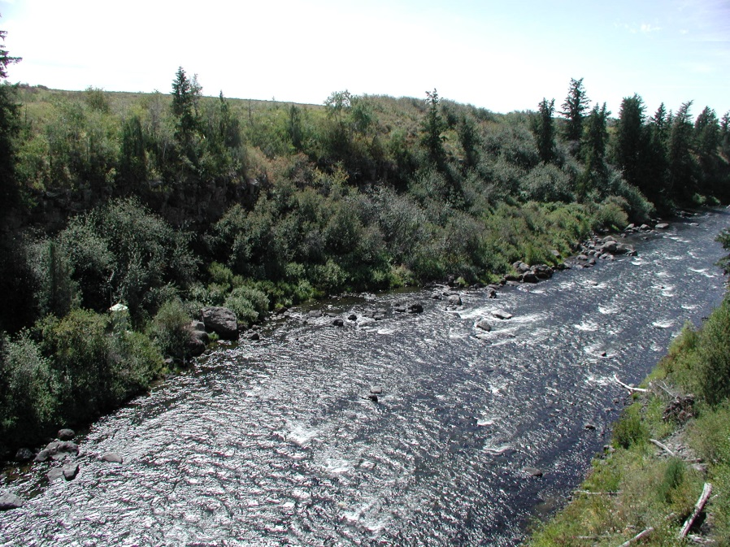
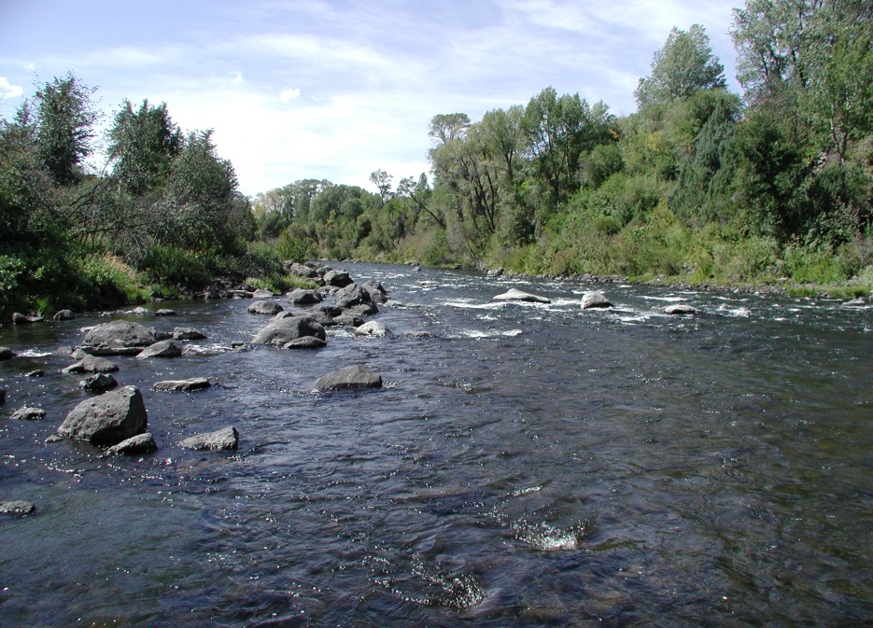
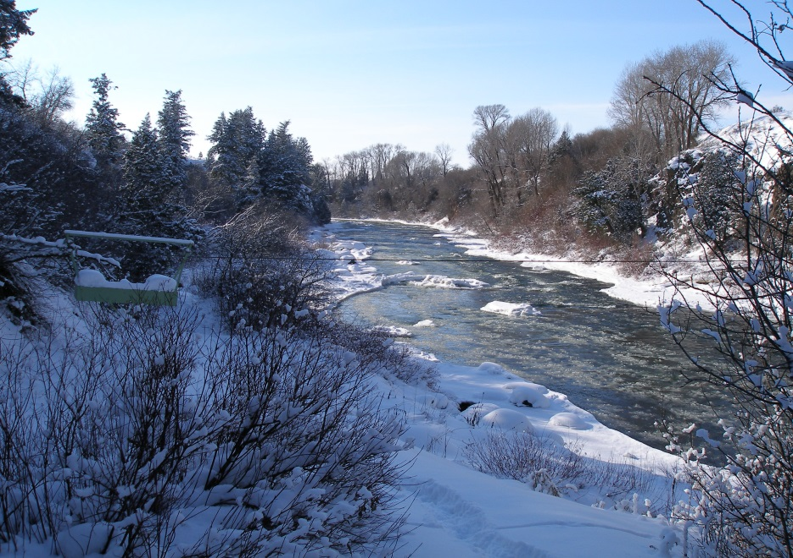
Falls River near Ashton, ID
Falls River near Ashton, ID
When establishing a new
gauge site, it is advisable to know
what the site will be like under
varied flow and weather conditions.
Falls River near Ashton, ID

Slide 23
Gauging stations located on outside bends of the channel tend to go dry during
low-flow conditions.
Notes:
The gravel riffle shown by the red arrows in this photograph forms a section control during low water at this site in Arizona

Slide 24
Camas Creek at Camas, ID

Slide 25
Camas Creek at Camas, ID

Slide 26
Falls River above the Yellowstone Canal near Squirrel, ID

Slide 27
Falls River above the Yellowstone Canal near Squirrel, ID

Slide 28
Other Considerations
Access
Proximity to good road
Property ownership
AC for sites with high power demands
Pumping samplers
2-way communications for VSAT, SCADA
Security

Slide 29
Site Selection Resources
For more information:
Measurement and Computation of Streamflow: Volumes 1 and 2, Geological Survey Water-Supply Paper 2175, S.E. Rantz
General Procedure For gauging Streams,
Techniques of Water Resources Investigations of the United States Geological Survey, Book 3 Chapter A6, R.W.Carter and Jacob Davidian

Slide 30
Gauge Site Selection
After many considerations, the precise site for the recording stage gauge is determined.
The location in the field is clearly documented by locating it by lat/long and plotting on a good map.
The next step is to establish the gauge datum.
Salmon River near Shoup, ID

Slide 31
Establishing and Maintaining Datum at Streamgauging Stations
Discharge is computed from water level (stage) by means of a stage-discharge rating.
Stage is monitored continuously and converted to discharge.
Therefore the accuracy of the computed discharge is directly correlated to accuracy of the measurement of stage.
Stage sensors have built-in accuracy and precision but the resulting data are only as accurate as their initial setting.
The “gauge datum” is the basis for this setting so special attention is required to ensure its accuracy.

Slide 32
Establishing and Maintaining Datum at Gauging Stations
North Fork Teton River at Teton, ID

Slide 33
Frequency of Levels
The following guidelines are followed by the USGS:
As a station is started, levels should be run every year for 3 years.
Levels at streamflow gauging stations should be run at least every 3 years.
If, after at least 5 sets of levels over a period of at least 10 years, the gauging station is shown to be stable the frequency of levels can be reduced to every 5 years.
When a station is discontinued, a level circuit should be run to finalize the documentation of datum.

Slide 34
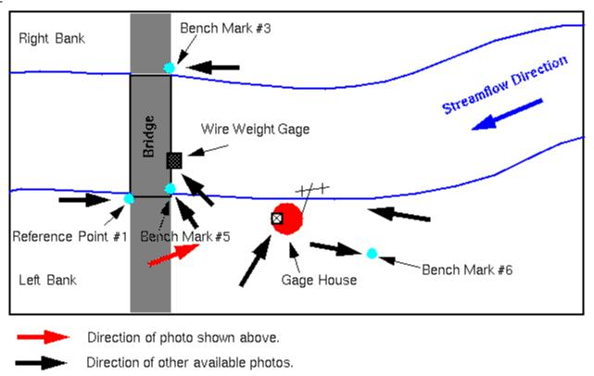
Plan View of gauge Site

Slide 35
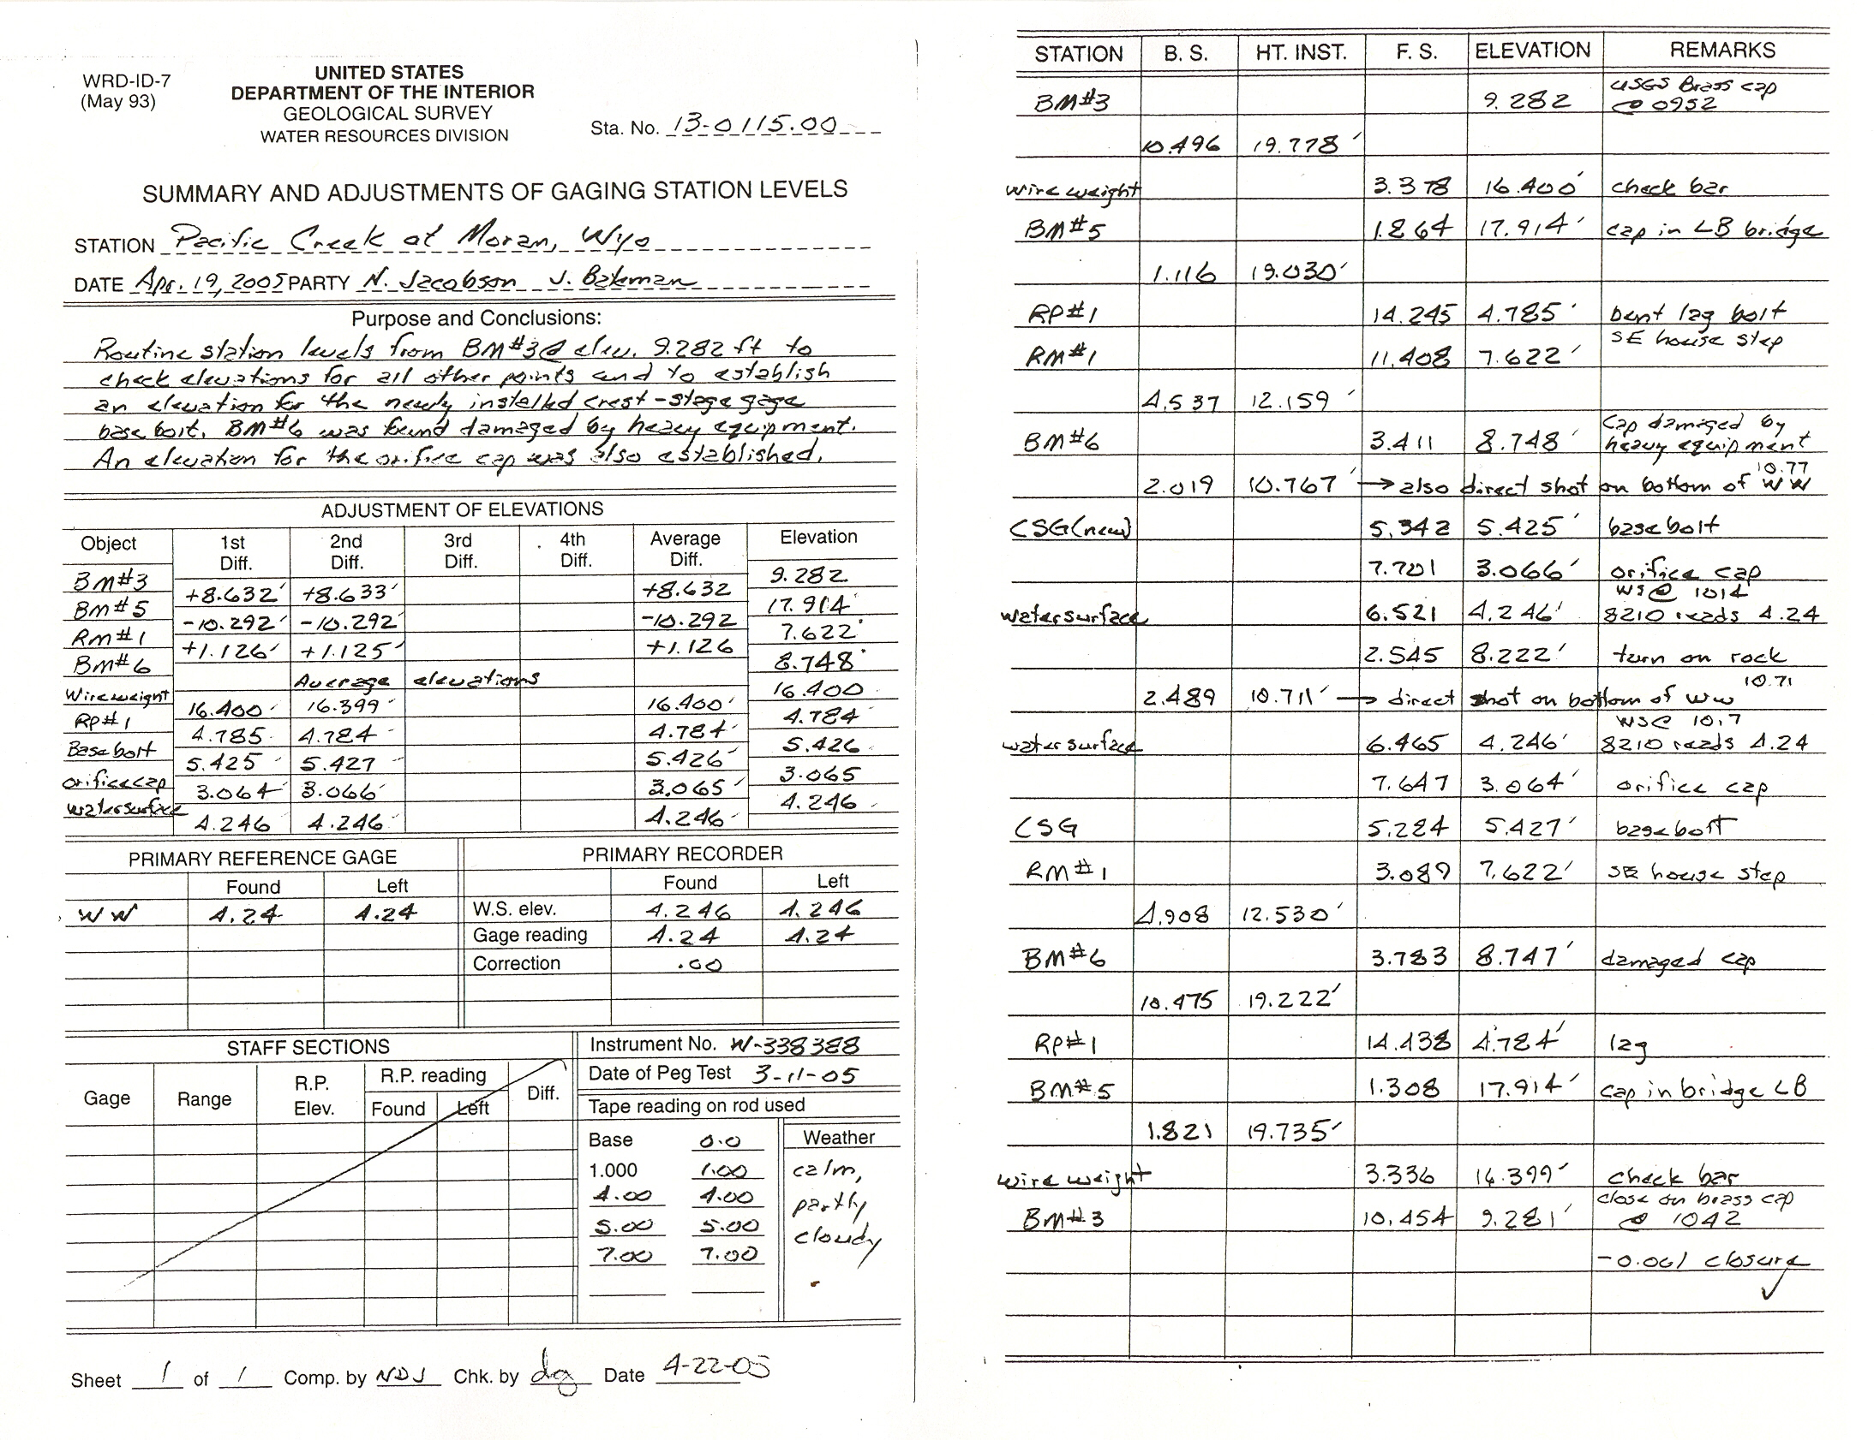

Slide 37
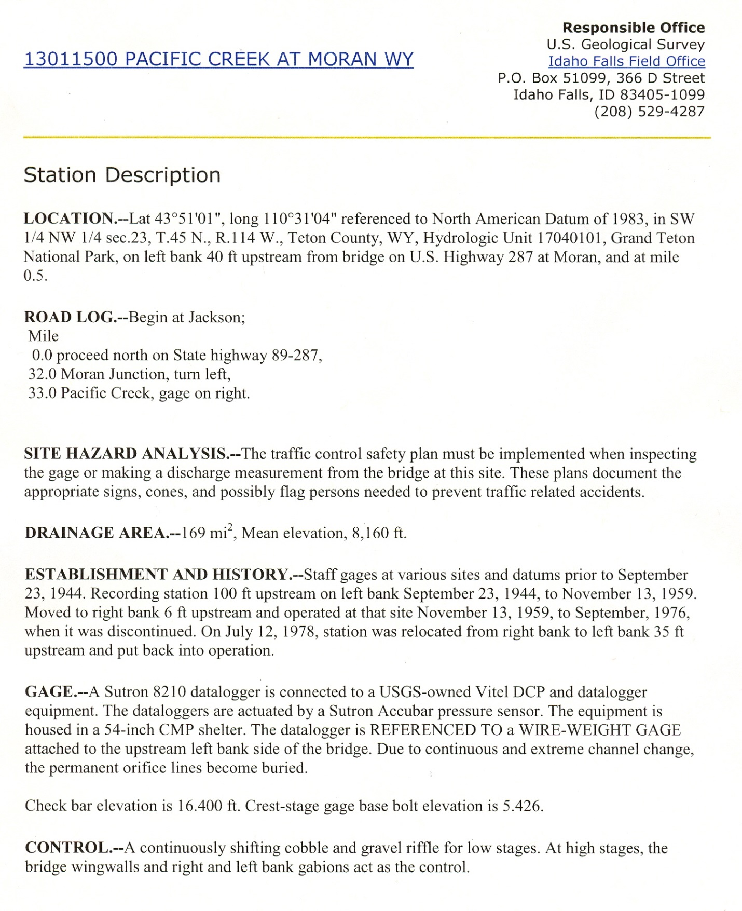

Slide 38
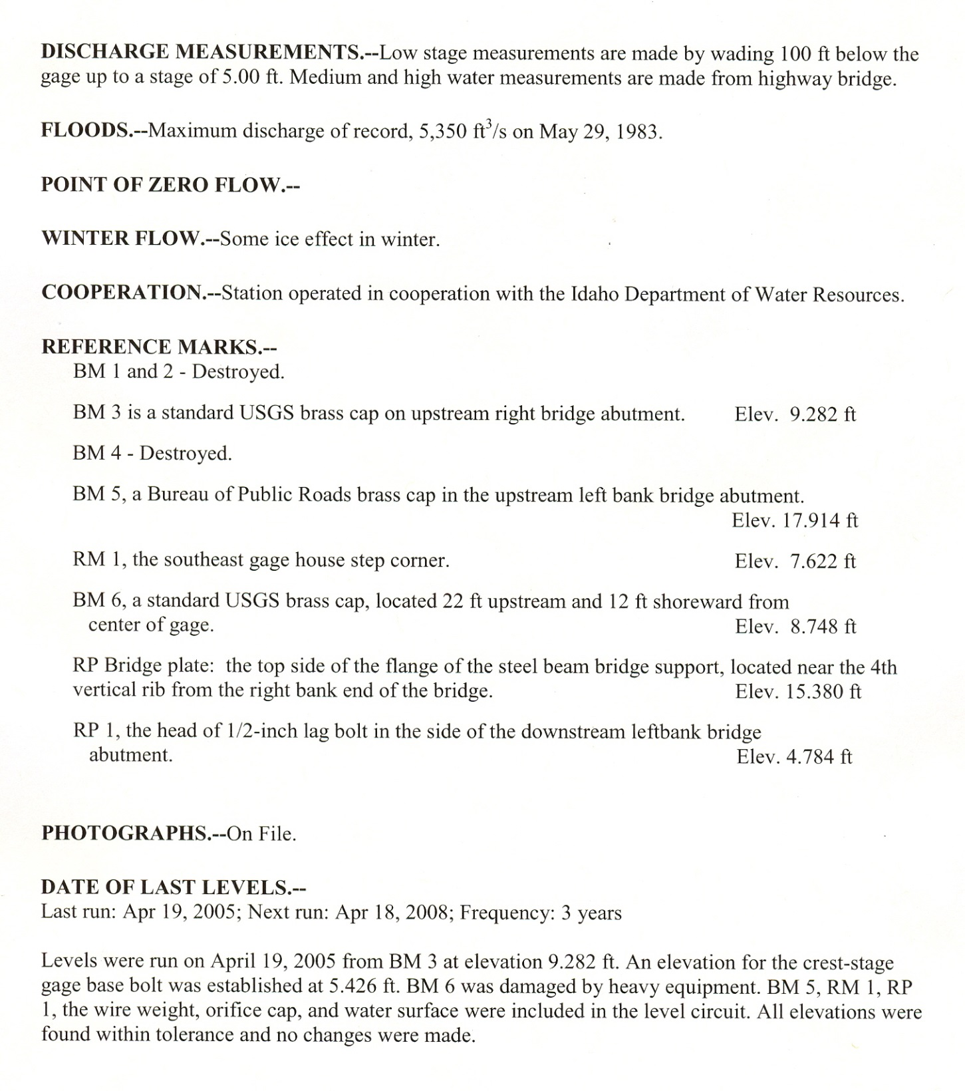

Slide 39
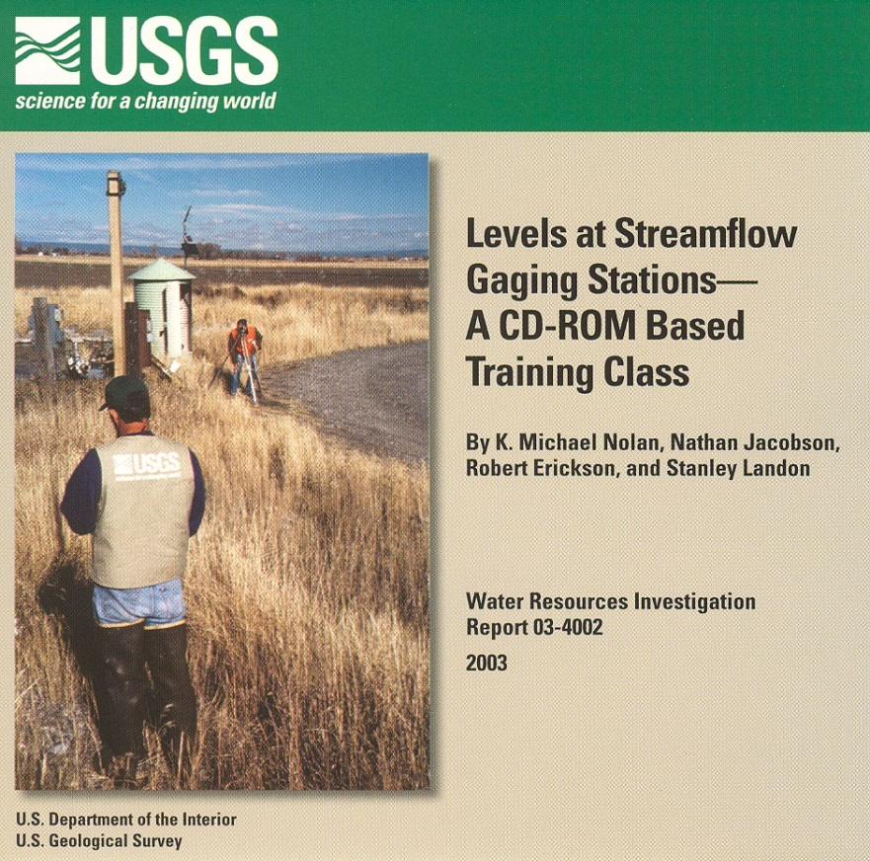
Levels at Gauging Stations
For more information:
Levels at Streamflow Gaging Stations,
E.J. Kennedy, TWRI, Book 3, Ch. A19
Levels at Streamflow Gaging Stations
A CD-ROM Training Class, K. Michael
Nolan, Nathan Jacobson, Robert Erickson, and Stanley Landon
OSW Memo 90.10 (levels frequency)
OSW Memo 93.12 (side shots)

Slide 40
Streamgauging Stations

Slide 41
Shelter built to house instruments above high water

Slide 42
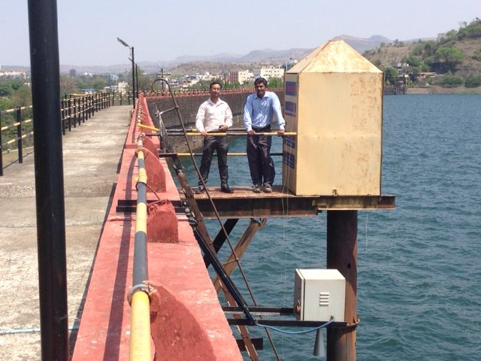
Stilling well with shaft encoder replaced by radar gauge

Slide 43
Simple construction works fine

Slide 44
Unless it’s too low!

Slide 45
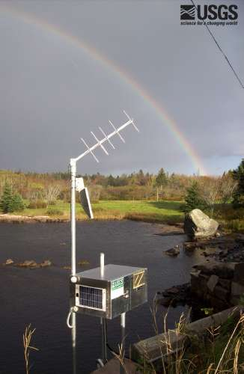
Modern technology allows for compact gauge installation

Slide 46
Crest Stage Gauge records high water mark in case of gauge failure

Slide 47
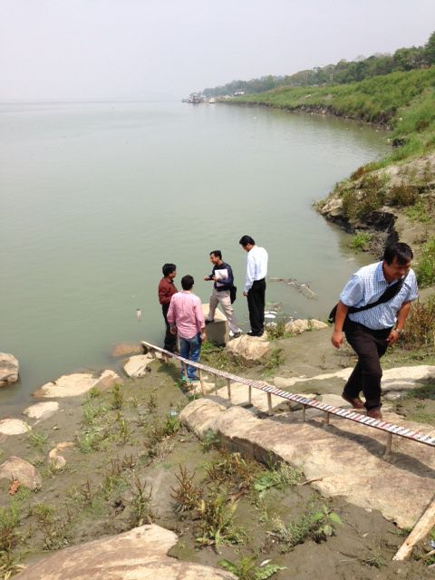
Sloping Staff Gauge for reference
Brahmaputra River at Guwahati

Slide 48
Cantilever –type reference gauge

Slide 49
Remote site with limited access

Slide 50
Estuary gauge

Slide 51
Cableway Structure
Cable
Backstay
Cablecar
A-Frame
Anchor

Slide 52
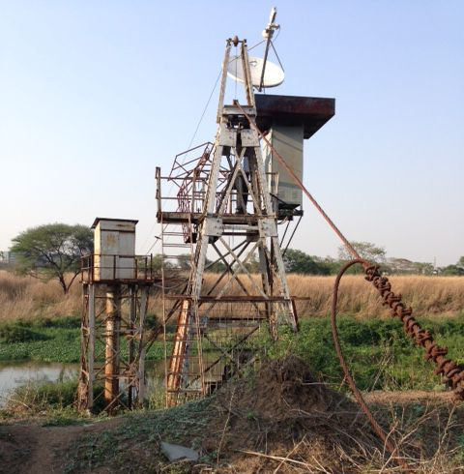
Cableway Structure Pune, Maharashtra

Slide 53
Cableways used for high-flow and large-river measurements

Slide 54
Built for highest expected flows

Slide 55
Remote locations with no bridges

Slide 56
Bank-Operated Cableway (hand powered)

Slide 57
Bank-operated Cableway in Himachal (electric powered)

Slide 60
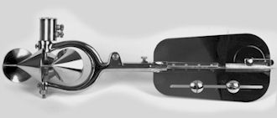
Traditional Price Meter Measurement

Slide 61
Tethered ADCP Measurement

Slide 62
Portable Cableway

Slide 63
Sediment and QW Sampling

Slide 64
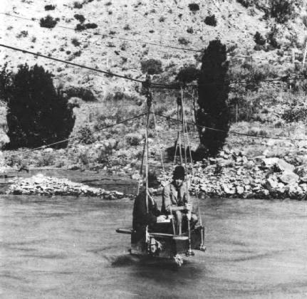
Questions?
Comments?

